Slide 1



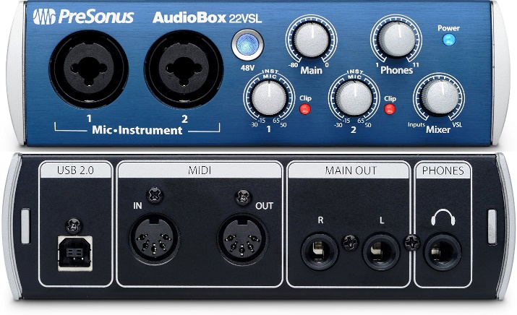
Interfaces and Abstraction
Interfaces vs Abstract Classes Abstraction vs Encapsulation
C# OOP
Advanced
SoftUni Team
Technical Trainers
Software University
http://softuni.bg

Slide 2

Table of Contents
Abstraction
Abstraction vs Encapsulation
Interfaces
Interfaces vs Abstract Classes

Slide 3
Questions
sli.do #CSharp-Fund

Slide 4
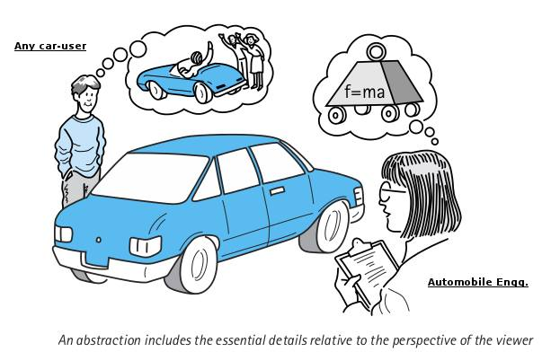
Abstraction

Slide 5
What is Abstraction?
From the Latin
Abs
(away from)
Trahere
(to draw)
Abstraction
Preserving information that is relevant in a given context, and forgetting information that is irrelevant in that context.
Notes:
Polymorphism is the ability of an object to take on many forms. The most common use of polymorphism in OOP occurs when a parent class reference is used to refer to a child class object.

Slide 6

Abstraction in OOP
Abstraction means ignoring irrelevant features, properties, or functions and emphasizing the relevant ones ...
... relevant to the context of the project we develop
Abstraction helps managing complexity
"Relevant" to what?
Notes:
Abstraction means ignoring irrelevant features, properties, or functions and emphasizing the relevant ones, relevant to the project we develop.
Abstraction helps managing complexity
Abstraction is something we do every day:
Looking at an object, we see those things that have meaning to us and ignore all others.
Represent a complex reality with a simplified model.
In a bank application, customers have:
name, phone and address, but they don’t have :
hair color and favorite drink, which we are disregarded from.

Slide 7
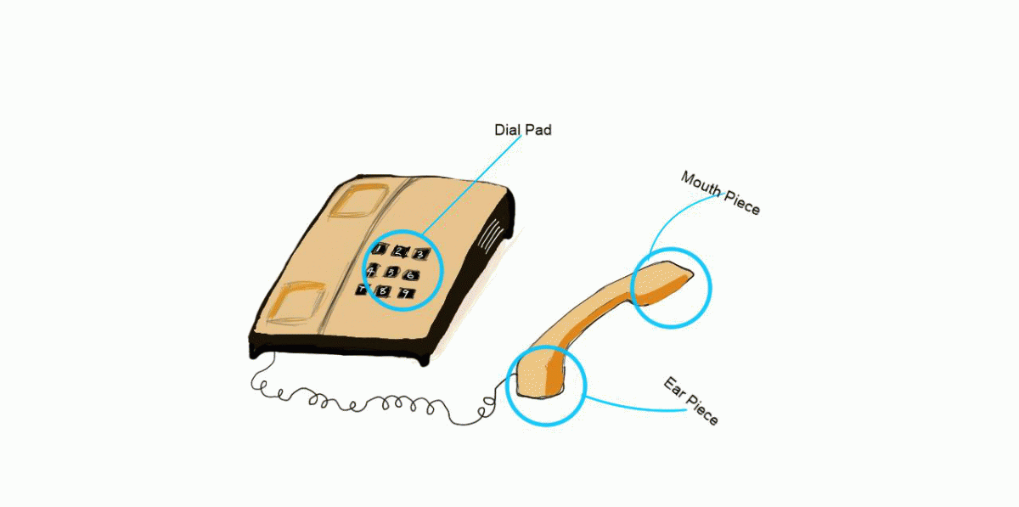
Abstraction Example
Abstraction lets you focus on what the object does instead of how it does it.
Notes:
Abstraction means ignoring irrelevant features, properties, or functions and emphasizing the relevant ones, relevant to the project we develop.
Abstraction helps managing complexity
Abstraction is something we do every day:
Looking at an object, we see those things that have meaning to us and ignore all others.
Represent a complex reality with a simplified model.
In a bank application, customers have:
name, phone and address, but they don’t have :
hair color and favorite drink, which we are disregarded from.

Slide 8
How do we achieve abstraction?
There are two ways to achieve abstraction
Interfaces (100% abstraction)
Abstract class (0% - 100% abstraction)
public interface IAnimal {}
public abstract class Mammal {}
public class Person : Mammal, IAnimal {}
Notes:
There are two ways to achieve abstraction
- Using Abstract Classes
- Using Interfaces

Slide 9
Abstraction vs. Encapsulation
Abstraction
Achieved with interfaces and abstract classes
Abstraction is a process of hiding the implementation details and showing only functionality to the user.
Encapsulation
Achieved with access modifiers (private, public…)
Encapsulation is used to hide the code and data inside a single unit to protect the data from the outside world
Notes:
There are two ways to achieve abstraction
- Using Abstract Classes
- Using Interfaces

Slide 10
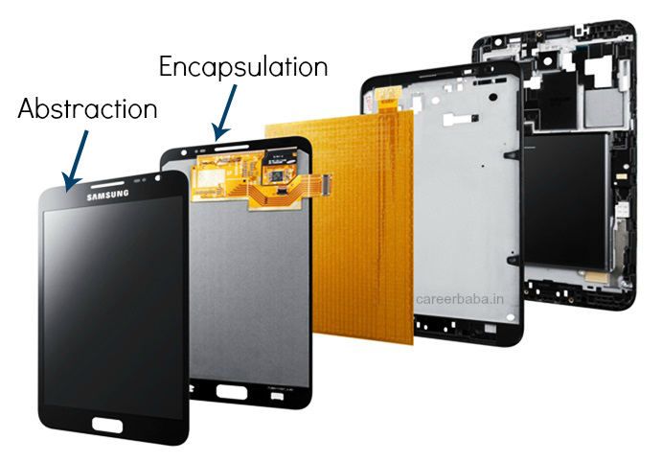
Abstraction vs Encapsulation (2)
Notes:
There are two ways to achieve abstraction
- Using Abstract Classes
- Using Interfaces

Slide 11

Interfaces

Slide 12
Interface
Keyword
Internal addition by compiler
public interface IPrintable
{
void Print();
}
Access modifier
Name
compiler
public interface IPrintable
{
public abstract void Print();
}
Adds public for all members
Notes:
There are two ways to achieve abstraction
- Using Abstract Classes
- Using Interfaces

Slide 13
Interface Example
Implementation of Print() is provided in class Document
public interface IPrintable
{
void Print();
}
class Document : IPrintable
{
public void Print()
{ Console.WriteLine("Hello"); }
}
Notes:
There are two ways to achieve abstraction
- Using Abstract Classes
- Using Interfaces

Slide 14
Multiple Inheritance
Relationship between classes and interfaces
Multiple inheritance
Class
Inteface
Inteface
extends
implements
extends
Class
Class
Inteface
Inteface
Inteface
Inteface
Inteface
implements
extends
Class
Inteface
Notes:
There are two ways to achieve abstraction
- Using Abstract Classes
- Using Interfaces

Slide 15
Problem: Shapes
Build a project that contains an interface for drawable objects
Implements two type of shapes: Circle and Rectangle
Both classes have to print on the console their shape with "*".
<<interface>>
IDrawable
+Draw()
<<IDrawable>>
Rectangle
<<IDrawable>>
Circle
-Width: int
-Height: int
+Radius: int
Notes:
There are two ways to achieve abstraction
- Using Abstract Classes
- Using Interfaces

Slide 16
Solution: Shapes
public interface IDrawable {
void Draw();
}
public class Rectangle : IDrawable {
//TODO Add fields and a constructor
public void Draw() { //TODO implement } }
public class Circle : Drawable {
//TODO Add fields and a constructor
public void Draw() { //TODO implement } }
Notes:
There are two ways to achieve abstraction
- Using Abstract Classes
- Using Interfaces

Slide 17
Solution: Shapes - Rectangle Draw
public void Draw()
{
DrawLine(this.Width, '*', '*');
for (int i = 1; i < this.Height - 1; ++i)
DrawLine(this.Width, '*', ' ');
DrawLine(this.Width, '*', '*');
}
private void DrawLine(int width, char end, char mid)
{
Console.Write(end);
for (int i = 1; i < width - 1; ++i)
Console.Write(mid);
Console.WriteLine(end);
}
Notes:
There are two ways to achieve abstraction
- Using Abstract Classes
- Using Interfaces

Slide 18
Solution: Shapes - Circle Draw
double rIn = this.Radius - 0.4;
double rOut = this.Radius + 0.4;
for (double y = this.Radius; y >= -this.Radius; --y)
{
for (double x = -this.Radius; x < rOut; x += 0.5)
{
double value = x * x + y * y;
if (value >= rIn * rIn && value <= rOut * rOut)
Console.Write("*");
else
Console.Write(" ");
}
Console.WriteLine();
}
Notes:
There are two ways to achieve abstraction
- Using Abstract Classes
- Using Interfaces

Slide 19
Interface vs Abstract Class
Abstract Class
A class may inherit only one abstract class.
Abstract class can provide implementation and/or just the singnature that have to be overridden.
Interface
A class may implement several interfaces.
An interface cannot provide any code, just the signature.
Notes:
There are two ways to achieve abstraction
- Using Abstract Classes
- Using Interfaces

Slide 20
Interface vs Abstract Class (2)
Abstract Class
An abstract class can contain access modifiers for the fields, functions, properties.
If various implementations are of the same kind and use common behavior or status then abstract class is better to use.
Interface
An interface cannot have access modifiers for the fields, functions, properties etc. everything is assumed as public
If various implementations only share method signatures then it is better to use Interfaces.
Notes:
There are two ways to achieve abstraction
- Using Abstract Classes
- Using Interfaces

Slide 21
Interface vs Abstract Class (3)
Abstract Class
An abstract class can have fields and constants defined
If we add a new method to an abstract class then we have the option of providing default implementation and therefore all the existing code might work properly.
Interface
No fields can be defined in interfaces
If we add a new method to an Interface then we have to track down all the implementations of the interface and define implementation for the new method.
Notes:
There are two ways to achieve abstraction
- Using Abstract Classes
- Using Interfaces

Slide 22
Problem: Cars
Build hierarchy of interfaces and classes
<<IElectricCar>>
<<ICar>>
+Battery
+Model: string
+Color: string
+Start(): string
+Stop(): string
Tesla
Seat
Notes:
There are two ways to achieve abstraction
- Using Abstract Classes
- Using Interfaces

Slide 23
Solution: Cars
public interface ICar
{
string Model { get; }
string Color { get; }
string Start();
string Stop();
}
public interface IElectricCar
{
int Batteries { get; }
}
Notes:
There are two ways to achieve abstraction
- Using Abstract Classes
- Using Interfaces

Slide 24
Solution: Cars (2)
public class Tesla : ICar, IElectricCar
{
public string Model { get; private set; }
public string Color { get; private set; }
public int Batteries { get; private set; }
public Tesla(string model, string color, int batteries)
{ //TODO: Add Logic here }
public string Start()
{ //TODO: Add Logic here }
public string Stop()
{ //TODO: Add Logic here }
}
Notes:
There are two ways to achieve abstraction
- Using Abstract Classes
- Using Interfaces

Slide 25
Solution: Cars (3)
public class Seat : ICar
{
public string Model { get; private set; }
public string Color { get; private set; }
public Tesla(string model, string color)
{ //TODO: Add Logic here }
public string Start()
{ //TODO: Add Logic here }
public string Stop()
{ //TODO: Add Logic here }
}
Notes:
There are two ways to achieve abstraction
- Using Abstract Classes
- Using Interfaces

Slide 26

Summary
Abstraction
How do we achieve abstraction
Interfaces
Abstract classes

Slide 27







Interfaces and Abstraction
https://softuni.bg/courses/csharp-oop-basics

Slide 28
License
This course (slides, examples, demos, videos, homework, etc.) is licensed under the "Creative Commons Attribution-NonCommercial-ShareAlike 4.0 International" license
Attribution: this work may contain portions from
"Fundamentals of Computer Programming with C#" book by Svetlin Nakov & Co. under CC-BY-SA license
"C# Part I" course by Telerik Academy under CC-BY-NC-SA license
"C# Part II" course by Telerik Academy under CC-BY-NC-SA license

Slide 29





Trainings @ Software University (SoftUni)
Software University – High-Quality Education, Profession and Job for Software Developers
softuni.bg
Software University Foundation
http://softuni.foundation/
Software University @ Facebook
facebook.com/SoftwareUniversity
Software University Forums
forum.softuni.bg

